Slide 1

Doing Math with R
Dr. Friedman

Slide 2
Preparation for your final project
Ideas for your final project. You can visit me at my office or via Skype or you can write an short outline proposal for your first package in R. The proposal must entail: the objectives of your package, the data source for the package, the type of statistics framework you will incorporate to the package and data format you will need to run the package.
Examples: http://user2015.math.aau.dk/lightning_talks
http://user2014.stat.ucla.edu/#poster-schedule
http://www.edii.uclm.es/~useR2013//docs/useR2013_abstract_booklet.pdf

Slide 3
Today’s topics
Very short Review
Univariate Data In statistics
In R
Categorical data
Bivariate Data
In statistics
In R
Bivariate data: numerical vs. numerical iv. Multivariate Data
In statistics
In R
v. Random Data
vi. Math Functions
Sorting
vii. If we will have time, Linear Algebra Operations on Vectors and Matrices

Slide 4
i. Short Review
Last time, we discussed data.frame and examined common data structures that are available in R: *Vectors
*Matrices
*Arrays *Lists *And data.frame

Slide 5
Statistical Measurement
In statistics, measurement of the data is the first step in the process that ultimately guides the final analysis.
Consideration of sampling, controls, errors (random and systematic) and the required precision all influence the final analysis.
Validation: Instruments and methods used to measure the data must be validated for accuracy.
Precision and accuracy…Determination of error
Social vs. Physical Sciences
ii. Statistical Analysis

Slide 6
ii. Introduction to Statistical Analysis
Types of data in statistical analysis:
Univariate: When we use one variable to describe a person, place, or thing.
Bivariate: when you use two variable to measure a person, place or thing
Multivariate: When we use two or more variables to measure a person, place or thing. Variables may or may not be dependent on each other.
Cross-sectional data/Time-ordered data (business, social sciences)
Cross-Sectional: Measurements taken at one time period
Time-Ordered: Measurements taken over time in chronological sequence.

Slide 7
ii. Introduction to Data Analysis
Measurement Scales (are used to categorize and/or quantify variables)
Categorical also known as Nominal Scale
Classification of people, places, or things into categories (e.g. age ranges, colors, etc.).
Classifications must be mutually exclusive (every element should belong to one category with no ambiguity).
Weakest of the four scales. No category is greater than or less (better or worse) than the others. They are just different.
Ordinal or Ranking Scale
Classification of people, places, or things into a ranking such that the data is arranged into a meaningful order (e.g. poor, fair, good, excellent).
Qualitative classification only

Slide 8
ii. Introduction to Data Analysis
Measurement Scales
Interval Scale
Data classified by ranking.
Quantitative classification (time, temperature, etc.).
Zero point of scale is arbitrary (differences are meaningful).
Ratio Scale
Data classified as the ratio of two numbers.
Quantitative classification (height, weight, distance, etc.).
Zero point of scale is real (data can be added, subtracted, multiplied, and divided).

Slide 9
iii. Univariate Data
It is a single-variable refers to data where we're only observing one aspect of something at a time. With single-variable data, we can put all our observations into a list of numbers.

Slide 10
iii. Univariate Analysis/Descriptive Statistics
Descriptive Statistics
The Range
Average
Median
Mode
Variance
Standard Deviation
Histograms and Normal Distributions

Slide 11
iii. Univariate Analysis/Histograms
Distributions
Descriptive statistics are easier to interpret when graphically illustrated.
Grouping the data elements into categories can be easy was to make sense of the data before applying advanced formulas.

Slide 12
iii. Univariate Analysis/Descriptive Statistics
The Range
Difference between minimum and maximum values in a data set
Larger range usually (but not always) indicates a large spread or deviation in the values of the data set.
(73, 66, 69, 67, 49, 60, 81, 71, 78, 62, 53, 87, 74, 65, 74, 50, 85, 45, 63, 100)
The code for Range in R: > range()

Slide 13
iii. Univariate Analysis/Descriptive Statistics
The Average (Mean)
Sum of all values divided by the number of values in the data set.
One measure of central location in the data set.
Average =
Average=(73+66+69+67+49+60+81+71+78+62+53+87+74+65+74+50+85+45+63+100)/20 = 68.6
The code for Mean in R:
> mean()

Slide 14
iii. Descriptive Statistics – the problem with Mean
0
2.5
7.5
10
The data may or may not be symmetrical around its average value
4.8
0
2.5
7.5
10
4.8

Slide 15
iii. Univariate Analysis/Descriptive Statistics
The Median
The middle value in a sorted data set. Half the values are greater and half are less than the median.
Another measure of central location in the data set.
(45, 49, 50, 53, 60, 62, 63, 65, 66, 67, 69, 71, 73, 74, 74, 78, 81, 85, 87, 100)
Median: 68
(1, 2, 4, 7, 8, 9, 9)
The code for Median in R:
>median()

Slide 16
iii. Descriptive Statistics – the problem with the Median
The Median
May or may not be close to the mean.
Combination of mean and median are used to define the skewness of a distribution.
0
2.5
7.5
10
6.25

Slide 17
iii. Univariate Analysis/Descriptive Statistics
The Mode
Most frequently occurring value.
Another measure of central location in the data set.
(45, 49, 50, 53, 60, 62, 63, 65, 66, 67, 69, 71, 73, 74, 74, 78, 81, 85, 87, 100)
Mode: 74
Generally not all that meaningful unless a larger percentage of the values are the same number.
The code for Range in R:
R does not have a standard in-built function to calculate mode. So we create a user function to calculate mode of a data set in R. This function takes the vector as input and gives the mode value as output.
Example: >firstmode <- function(v) {
uniqv <- unique(v)
uniqv[which.max(tabulate(match(v, uniqv)))]
}
v <- c(2,1,2,3,1,2,3,4,1,5,5,3,2,3)
>result <- firstmode(v)
>result [1] 2

Slide 18
iii. Univariate Analysis/Descriptive Statistics
Variance
One measure of dispersion (deviation from the mean) of a data set. The larger the variance, the greater is the average from the average value.
Variance =
Average value of the data set
Variance = [(45 – 68.6)² + (49 – 68.6)² + (50 – 68.6)² + (53 – 68.6)² + …]/20 = 181
The code for Range in R:
R code: var()

Slide 19
iii. Univariate Analysis/Descriptive Statistics
Standard Deviation
Square root of the variance. Can be thought of as the average deviation from the mean of a data set.
The magnitude of the number is more in line with the values in the data set.
Standard Deviation = ([(45 – 68.6)² + (49 – 68.6)² + (50 – 68.6)² + (53 – 68.6)² + …]/20)^{1/2} = 13.5
The code for Range in R: >sd()

Slide 20
iii. Univariate Analysis/Normal Distributions
Distributions that can be described mathematically as Gaussian are also called Normal
The Bell curve
Symmetrical
Mean ≈ Median
Mean, Median, Mode

Slide 21
iii. Univariate Analysis/Skewed Distributions
When data are skewed, the mean and SD can be misleading
Skewness
sk= 3(mean-median)/SD
If sk>|1| then distribution is non-symetrical
Negatively skewed
Mean<Median
Sk is negative
Positively Skewed
Mean>Median
Sk is positive

Slide 22
iii. Categorical data under Univariate data
What is categorical data?
Categorical data is the statistical data type consisting of categorical variables or of data that has been converted into that form, for example as grouped data.
How do we organize/analyze this type categorical one variable data?
The answer: Histograms
The following example of different histograms based on categorical and univariate data in R

Slide 23
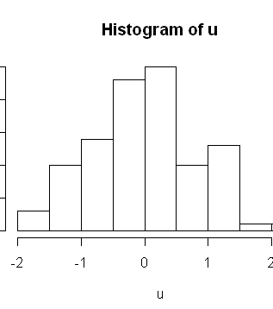
III. Example of categorical data using histogram
>set.seed(121343) >u <- rnorm(100)
> hist(u)

Slide 24
iii. Probability Distributions
>> A probability distribution is a table or an equation that links each outcome of a statistical experiment with its probability of occurrence.
To understand probability distributions, it is important to understand variables. random variables, and some notation.
A variable is a symbol (A, B, x, y, etc.) that can take on any of a specified set of values.
When the value of a variable is the outcome of a statistical experiment, that variable is a random variable.
Generally, statisticians use a capital letter to represent a random variable and a lower-case letter, to represent one of its values. For example,
X represents the random variable X.
P(X) represents the probability of X.
P(X = x) refers to the probability that the random variable X is equal to a particular value, denoted by x. As an example, P(X = 1) refers to the probability that the random variable X is equal to 1.

Slide 25
iii. Probability Distributions
By prefixing a "d" to the function name, you can get probability density values (pdf).
By prefixing a "p", you can get cumulative probabilities (cdf).
By prefixing a "q", you can get quantile values.
By prefixing an "r", you can get random numbers from the distribution.
> I will demonstrate using the normal distribution.
The dnorm( ) function returns the height of the normal curve at some value along the x-axis. Here the value of dnorm(1) is shown by the vertical line at x=1...
> dnorm(1)
[1] 0.2419707

Slide 26
Random Variable
A random variable is a variable that assumes numerical values associated with the random outcomes of an experiment, where one (and only one) numerical value is assigned to each sample point.

Slide 27
Discrete Random Variable
Random variables that can assume a countable number (finite or infinite) of values are called discrete.

Slide 28
Discrete Random Variable Examples
Random Variable
Possible Values
Experiment
Make 100 Sales Calls
# Sales
0, 1, 2, ..., 100
Inspect 70 Radios
# Defective
0, 1, 2, ..., 70
Answer 33 Questions
# Correct
0, 1, 2, ..., 33
Count Cars at Toll
# Cars
0, 1, 2, ..., ∞
Between 11:00 & 1:00
Arriving

Slide 29
Continuous Random Variable
Random variables that can assume values corresponding to any of the points contained in one or more intervals (i.e., values that are infinite and uncountable) are called continuous.

Slide 30
Continuous Random Variable Examples
Random Variable
Possible Values
Experiment
Weigh 100 People
Weight
45.1, 78, ...
Measure Part Life
Hours
900, 875.9, ...
Amount spent on food
$ amount
54.12, 42, ...
Measure Time
Inter-Arrival
0, 1.3, 2.78, ...
Between Arrivals
Time

Slide 31
Discrete Probability Distribution
The probability distribution of a discrete random variable is a graph, table, or formula that specifies the probability associated with each possible value the random variable can assume.

Slide 32
Requirements for the Probability Distribution of a Discrete Random Variable x
p(x) ≥ 0 for all values of x
Σ p(x) = 1
where the summation of p(x) is over all possible
values of x.

Slide 33
Discrete Probability Distribution Example
Experiment: Toss 2 coins. Count number of tails.
Probability Distribution
Values, x Probabilities, p(x)
0 1/4 = .25
1 2/4 = .50
2 1/4 = .25

Slide 34
Visualizing Discrete Probability Distributions
Listing
Table
{ (0, .25), (1, .50), (2, .25) }
f(x)
p(x)
# Tails
Count
0
1
.25
1
2
.50
Graph
2
1
.25
p(x)
.50
.25
Formula
.00
x
n
!
p
(
x
)
=
p^{x}(1 – p)^{n – x}
0
1
2
x!(n – x)!
Notes:
Experiment is tossing 1 coin twice.

Slide 35
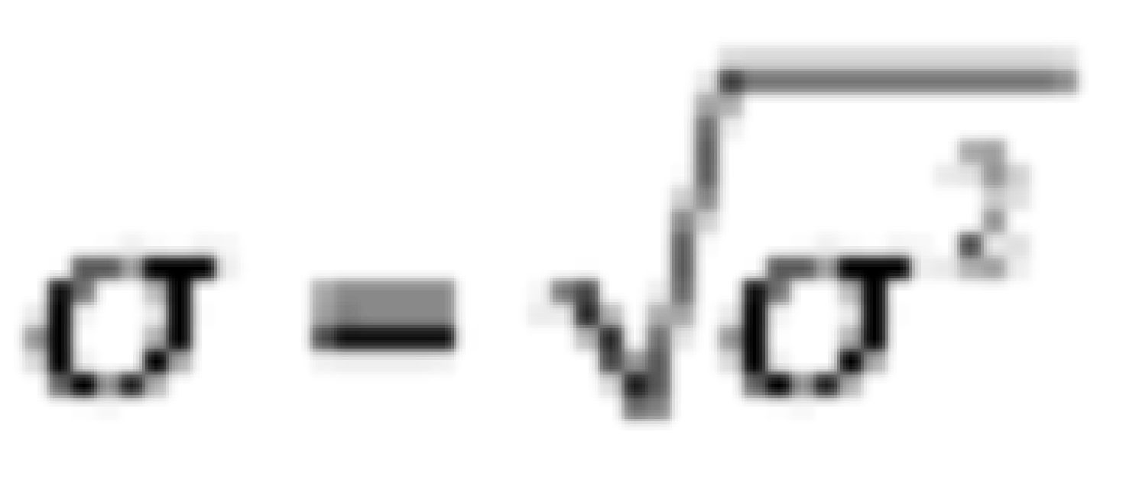
Summary Measures
Expected Value (Mean of probability distribution)
Weighted average of all possible values
μ = E(x) = Σx p(x)
Variance
Weighted average of squared deviation about mean
σ² = E[(x − μ)²] = Σ (x − μ)² p(x)
3. Standard Deviation
●
Notes:
population notation is used since all values are specified.

Slide 36
iii. What is probability Distribution Density?
What is Density estimation in probability Distribution?
Density estimation is the construction of an estimate, based on observed data, of an unobservable underlying probability density function. The unobservable density function is thought of as the density according to which a large population is distributed; the data are usually thought of as a random sample from that population.
R has density and distribution functions built-in for about 20 probability distributions, including those in the following table:
Distribution | Function | type
Binomial | binom | Discrete
Chi-squared | chisq | continuous
F | f | continuous
hypergeometric | hyper | discrete
normal | normal | continuous
Poisson | pois | discrete
Student’s test | t | continuous
uniform | unif | continuous

Slide 37
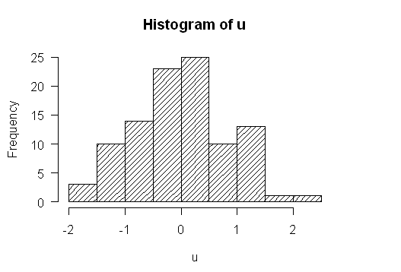
iii. Histogram with shading
> hist(u, density=20)

Slide 38
iii. #with specific number of bins
>hist(u, density=20, breaks=20)

Slide 39
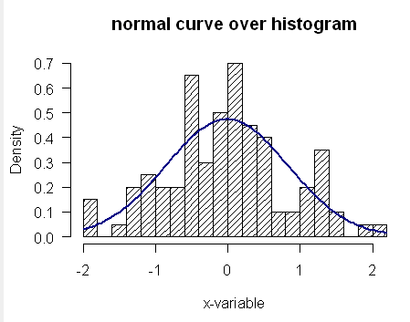
iii. #with curve over histogram
>m<-mean(u)
>std<-sqrt(var(u))
>hist(u, density=20, breaks=20, prob=TRUE,
xlab="x-variable", ylim=c(0, 0.7),
main="normal curve over histogram")
curve(dnorm(x, mean=m, sd=std),
col="darkblue", lwd=2, add=TRUE)

Slide 40
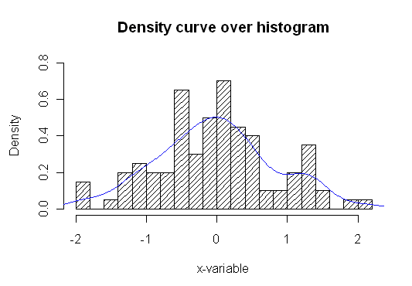
iii. Density curve over histogram
>hist(u, density=20, breaks=20, prob=TRUE,
xlab="x-variable", ylim=c(0, 0.8),
main="Density curve over histogram")
lines(density(u), col = "blue")

Slide 41
iv. Bivariate Analysis
Bivariate analysis focus on the relationship between two variables only !!

Slide 42
iv. Bivariate Analysis
Suppose a student survey is done to evaluate if students who smoke study less. The data recorded is
Person | Smokes | Amount of studying
1 | Y | Less than 5 hours
2 | N | 5-10 hours
3 | N | 5-10 hours
4 | Y | More than 10 hours
5 | N | More than 10 hours
6 | Y | Less than 5 hours
7 | Y | 5-10 hours
8 | Y | Less than 5 hours
9 | N | More than 5 hours
10 | Y | 5-10 hours

Slide 43
iv. In R
We can handle this in R by creating two vectors to hold our data, and then using the table command.
> smokes = c("Y","N","N","Y","N","Y","Y","Y","N","Y")
> amount = c(1,2,2,3,3,1,2,1,3,2)
> table(smokes, amount)
amount
smokes 1 2 3
N 0 2 2
Y 3 2 1

Slide 44
iv. The examination of Relationship?
What would be nice to have are the marginal totals and the proportions. For example, what proportion of smokers study 5 hours or less. We know that this is 3 /(3+2+1) = 1/2, but how can we do this in R?
The command prop.table will compute this for us. It needs to be told the table to work on, and a number to indicate if you want the row proportions (a 1) or the column proportions (a 2) the default is to just find proportions.
> tmp=table(smokes,amount) # store the table > old.digits = options("digits") # store the number of digits > options(digits=3) # only print 3 decimal places > prop.table(tmp,1) # the rows sum to 1 now
amount smokes 1 2 3 N 0.0 0.500 0.500 Y 0.5 0.333 0.167 > prop.table(tmp,2) # the columns sum to 1 now
amount
smokes 1 2 3
N 0 0.5 0.667
Y 1 0.5 0.333

Slide 45
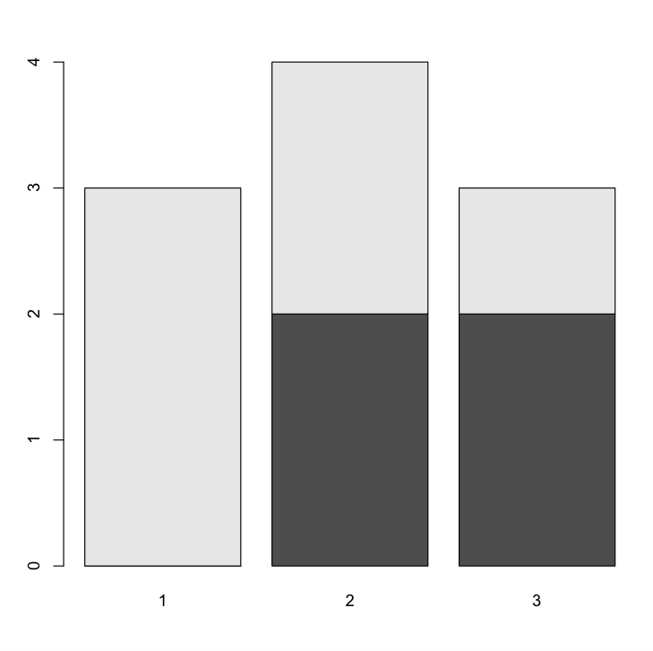
iv. Use of Barplot
>barplot(table(amount,smokes)

Slide 46
iv. Handling bivariate data: categorical vs. numerical
Suppose you have numerical data for several categories. A simple example might be in a drug test, where you have data (in suitable units) for an experimental group and for a control group.
experimental: 5 5 5 13 7 11 11 9 8 9
control: 11 8 4 5 9 5 10 5 4 10
You can summarize the data separately and compare, but how can you view the data together? A side by side boxplot is a good place to start. To generate one is simple:
> x = c(5, 5, 5, 13, 7, 11, 11, 9, 8, 9)
> y = c(11, 8, 4, 5, 9, 5, 10, 5, 4, 10)
> boxplot(x,y)

Slide 47
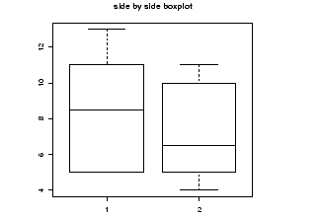
iv. The result in Boxplot

Slide 48
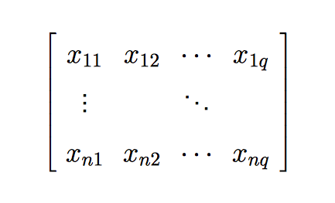
v. Multivariate Analysis
Multivariate Analysis allow the separate and combined effects of the independent variable to be examined.
Notation: We have n units (“individuals”) and q variables in a multivariate data set, where q > 1
The observation can be represented in matrix form

Slide 49
V. Multivariate Data
In R, we often used data.frame to capture multivariate data.
> weight = c(150, 135, 210, 140)
> height = c(65, 61, 70, 65)
> gender = c("Fe","Fe","M","Fe")
> study = data.frame(weight,height,gender) # make the data frame
> study
weight height gender
1 150 65 Fe
2 135 61 Fe
3 210 70 M
4 140 65 Fe

Slide 50
v. Manipulating data frames: stack and unstack
This simple reshaping of a data object is common enough that R includes three functions. The first is stack() function that allow us to go from wide to long. The second function is unstack() that allow us to go from long to wide for perfectly rectangular data. The last function is reshape() that aims for more complex transposition, it is very complex situations.
stack() and unstack()
Note that all columns in the wide version must be of the same length, or each block of values in the long version must be of the same length.
long <- stack(wide) wide2 <- unstack(long)
In some instances, there are two different ways to store data. Let’s look at data set called PlantGrowth
> data(PlantGrowth)
> PlantGrowth
weight group
1 4.17 ctrl
2 5.58 ctrl
3 5.18 ctrl
4 6.11 ctrl

Slide 51
V. Stack and unstack continues
In this data, there are 3 groups a control and two treatments. For each group, weights are recorded. The data is generated this way, by recording a weight and group for each plant. However, you may want to plot boxplots for the data broken down by their group.
How to do this?
A brute force way is do as follows for each value of group
> attach(PlantGrowth)
> weight.ctrl = weight[group == "ctrl"]
This quickly way but it grows tiresome. The unstack function will do this all at once for us. If the data is structured correctly, it will create a data frame with variables corresponding to the levels of the factor.

Slide 52
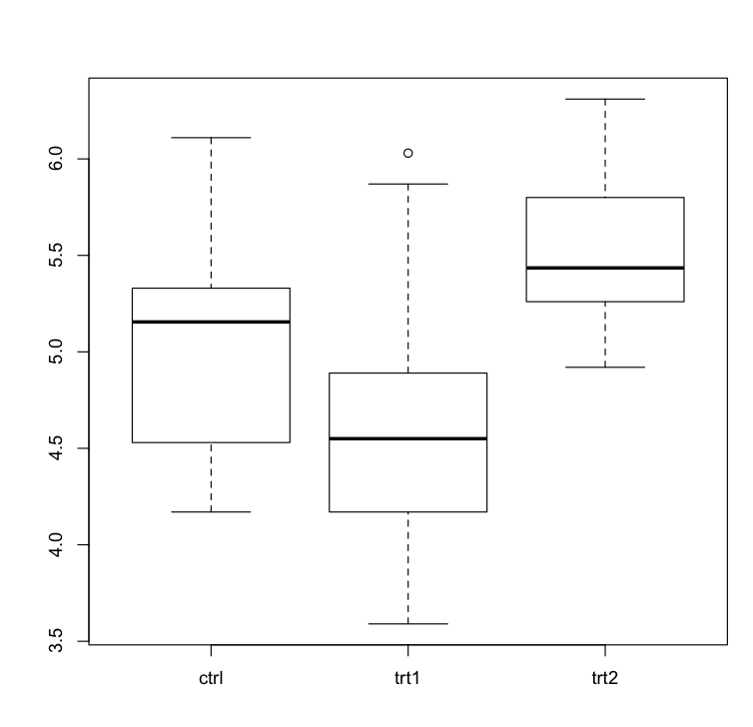
V. Stack and unstack continuous
> unstack(PlantGrowth)
ctrl trt1 trt2
1 4.17 4.81 6.31
2 5.58 4.17 5.12
3 5.18 4.41 5.54
6.11 3.59 5.50
>boxplot(unstack(PlantGrowth))

Slide 53
V. Using R's model formula notation
The model formula notation that R uses allows this to be done in a systematic manner.
We will use the following formula: boxplot(weight ~ group)
The idea of this formula is to illustrate and measure, if the weight variable break down by values of the group factor and hands.
In this case, there are two variables. The response variable is on the left hand side and the predictor on the right:
-> -> response ~ predictor (when two variables)

Slide 54
Here are table with three variables Y, X1, X2
Formula | Meaning
Y ~ X1 | Y is modeled by X1
Y ~ X1 + X2 | Y is modeled by X1 and X2 as in multiple regression
Y ~ X1 * X2 | Y is modeled by X1, X2 and X1*X2
(Y ~ (X1 + X2)^2) | Two-way interactions. Note usual powers
Y ~ X1+ I((X2^2) | Y is modeled by X1 and X22
Y ~ X1 | X2 | Y is modeled by X1 conditioned on X2

Slide 55
VI. Random number in R
In R has a comprehensive library of functions for generating random numbers from various statistical distributions.
In this module I will focus on the simplest of questions: How do I generate a random number?

Slide 56
VI. Random number in R
Generate a random number between 2.0 and 10.0 If you want to generate a decimal number where any value (including fractional values) between the stated minimum and maximum is equally likely, use the runif function. This function generates values from the Uniform distribution. Here's how to generate one random number between 2.0 and 10.0:
> x1 <- runif(1, 2.0, 10.0) > x1 [1] 8.379401

Slide 57
VI. Random number in R
Of course, when you run this, you'll get a different number, but it will definitely be between 2.0 and 10.0. You won't get the values 2.0 or 10.0 exactly, either.
If you want to generate multiple random values, don't use a loop. You can generate several values at once by specifying the number of values you want as the first argument to runif. Here's how to generate 10 values between 2.0 and 10.0:
> x2 <- runif(10, 2.0, 10.0) > x2 [1] 4.942176 2.357028 6.192514 3.132861 3.768622 2.060440 8.903294 9.926701……………….

Slide 58
VI. Random number in R
Generate a random integer between 1 and 10
This looks like the same exercise as we did in the last one, but now we only want whole numbers, not fractional values. For that, we use the sample function:
> x3 <- sample(1:10, 1)
> x3
[1] 4
The first argument is a vector of valid numbers to generate (here, the numbers 1 to 10), and the second argument indicates one number should be returned. If we want to generate more than one random number, we have to add an additional argument to indicate that repeats are allowed:
> x4 <- sample(1:10, 5, replace=T)
> x4
[1] 6 9 7 6 5

Slide 59
VIII. Math functions
R can perform the usual mathematical operations, below are the functions:
Arithmetic
+ – addition
– – subtraction
* – multiplication
/ – division
Trigonometry
sin – sine
cos – cosine
tan – tangent
asin – sine inverse
acos – cosine inverse
atan – tangent inverse
Linear Algebra
+ – element-wise addition
– – element-wise subtraction
* – element-wise multiplication
/ – element-wise division
%*% – matrix multiplication
t – transpose
eigen – eigenvalues and eigenvectors
solve – inverse of matrix
ginv – generalized inverse, requires MASS package
rbind – combines vectors of observations horizontally into matrix class
cbind – combines vectors of observations vertically into matrix class
Reference:
Kabacoff, R. I. Matrix Algebra. Quick-R. Retrieved April 20, 2013

Slide 60
VIII. Matrix Algebra
Definition
An n × m matrix, A, is a rectangular array of elements
n = # of columns
m = # of rows
dimensions = n × m

Slide 61
VIII. Vector
A vector, v, of dimension n is an n × 1 matrix rectangular array of elements
vectors will be column vectors (they may also be row vectors)

Slide 62
VIII. Vector continue
A vector, v, of dimension n
can be thought a point in n dimensional space

Slide 63
v₃
v₂
v₁

Slide 64
Matrix Operations
Addition
Let A = (a_{ij}) and B = (b_{ij}) denote two n × m matrices Then the sum, A + B, is the matrix
The dimensions of A and B are required to be both n × m.

Slide 65
Scalar Multiplication
Let A = (a_{ij}) denote an n × m matrix and let c be any scalar. Then cA is the matrix

Slide 66
Addition for vectors
v₃
v₂
v₁

Slide 67
Scalar Multiplication for vectors
v₃
v₂
v₁

Slide 68
Matrix multiplication
Let A = (a_{ij}) denote an n × m matrix and B = (b_{jl}) denote an m × k matrix
Then the n × k matrix C = (c_{il}) where
is called the product of A and B and is denoted by A∙B

Slide 69
In the case that A = (a_{ij}) is an n × m matrix and B = v = (v_{j}) is an m × 1 vector
Then w = A∙v = (w_{i}) where
is an n × 1 vector
w₃
v₃
w₂
v₂
w₁
v₁

Slide 70
Definition
An n × n identity matrix, I, is the square matrix
Note:
AI = A
IA = A.

Slide 71
Definition (The inverse of an n × n matrix)
Let A denote the n × n matrix
Let B denote an n × n matrix such that
AB = BA = I,
If the matrix B exists then A is called invertible Also B is called the inverse of A and is denoted by A⁻¹

